Slide 1

Crunchbase Start-up analysis
Ali Rafiee
Aspiring Data Scientist

Slide 2
Introduction
Increase in startup investment, with billions of dollars invested by venture capitalists, angel investors, and others.
Use of data and technology to inform investment decisions.
Crunchbase dataset contains information on over 6,000 startup investments.
Project uses dataset to analyze trends and identify investment opportunities through descriptive and predictive analytics.
Result: Valuable insights for informed investment decisions.

Slide 3
Objectives
What percentage of the start-ups through the time could successfully continue operating?
Which markets perform best in terms of investment attractivity?
Is average seed investment different for successful and unsuccessful start-ups? if they are different, is the difference significant?
What are the top 10 markets with the most start-ups?
How does the total and average funding received differ from one industry to another?
…

Slide 4

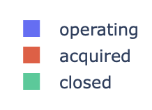
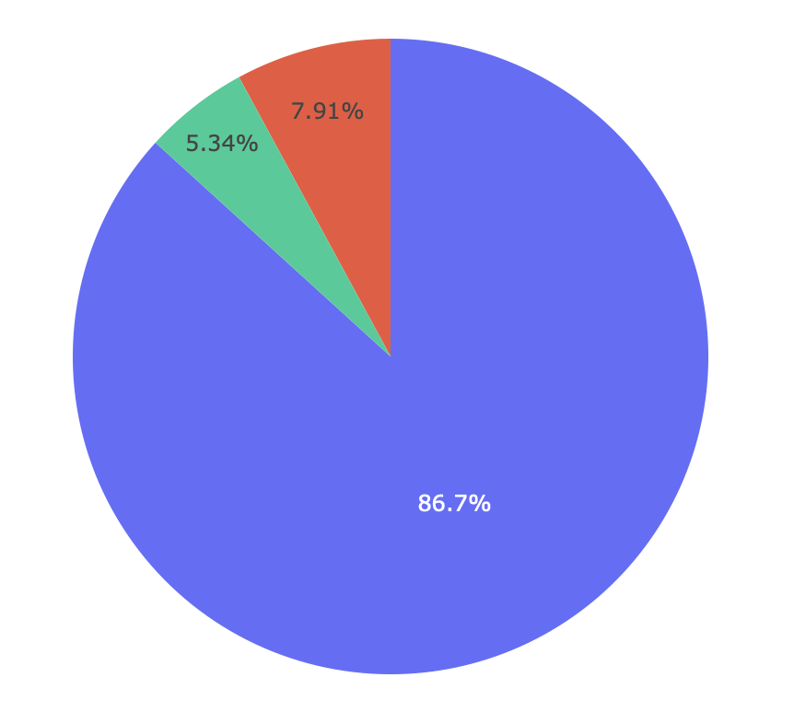

Slide 5

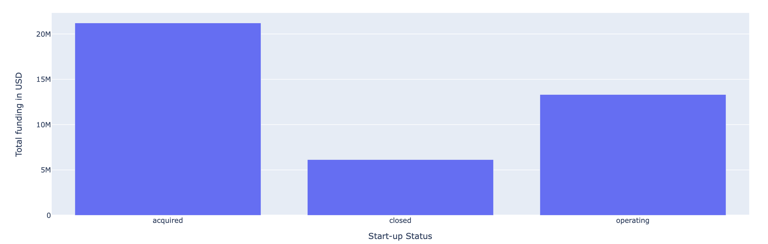

Slide 6
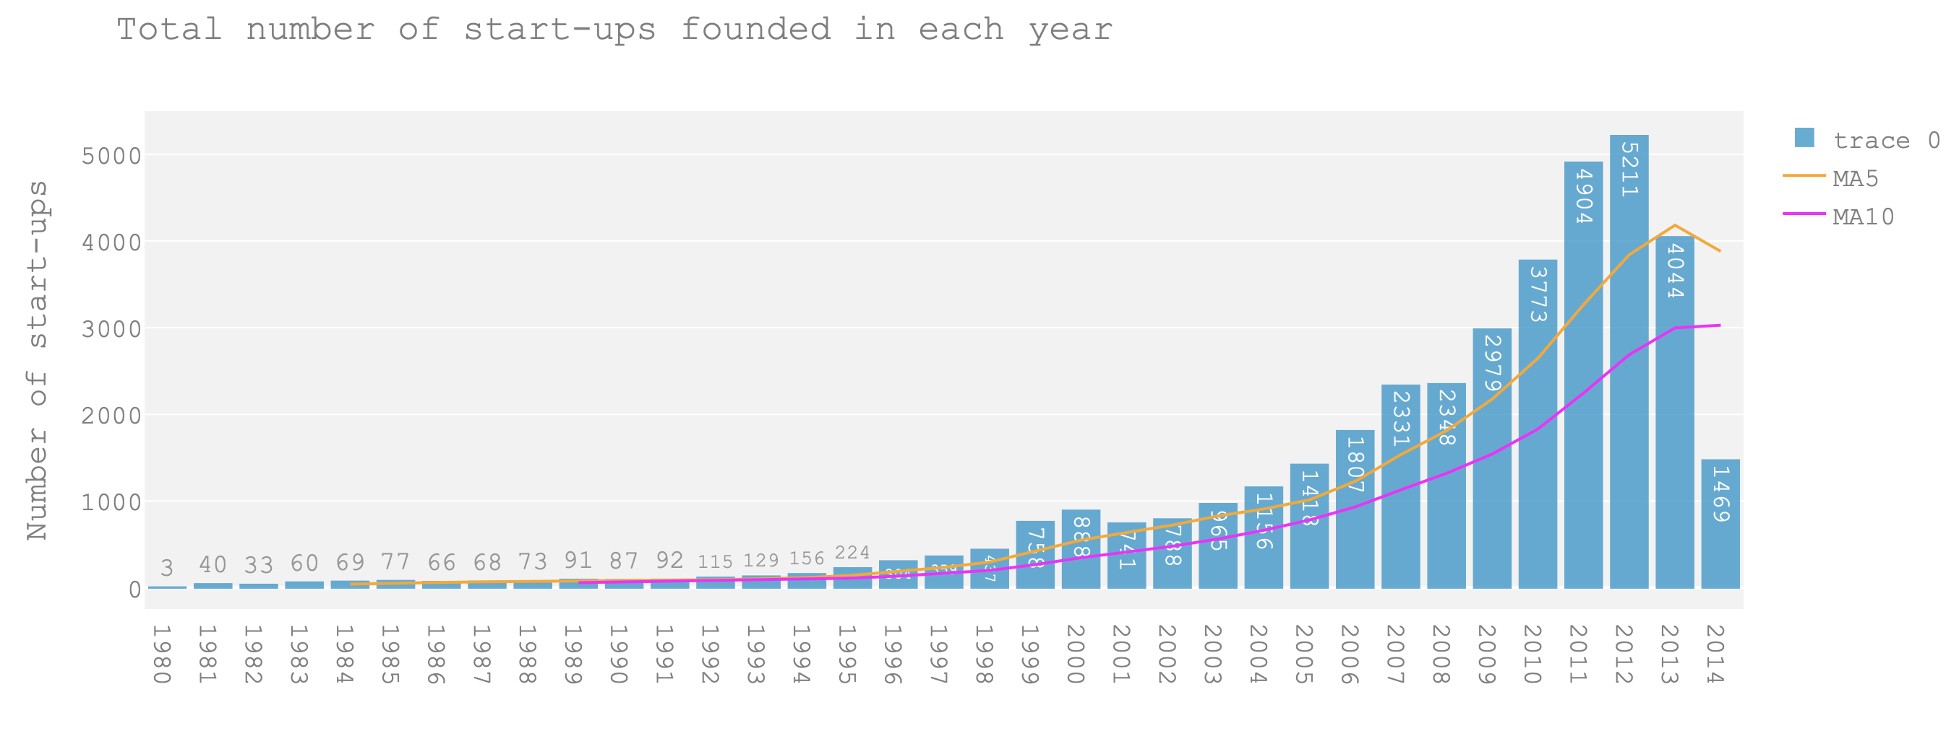

Slide 7
